Slide 1

Dr. Greenthumb
Decoding Nature's Needs

Slide 2

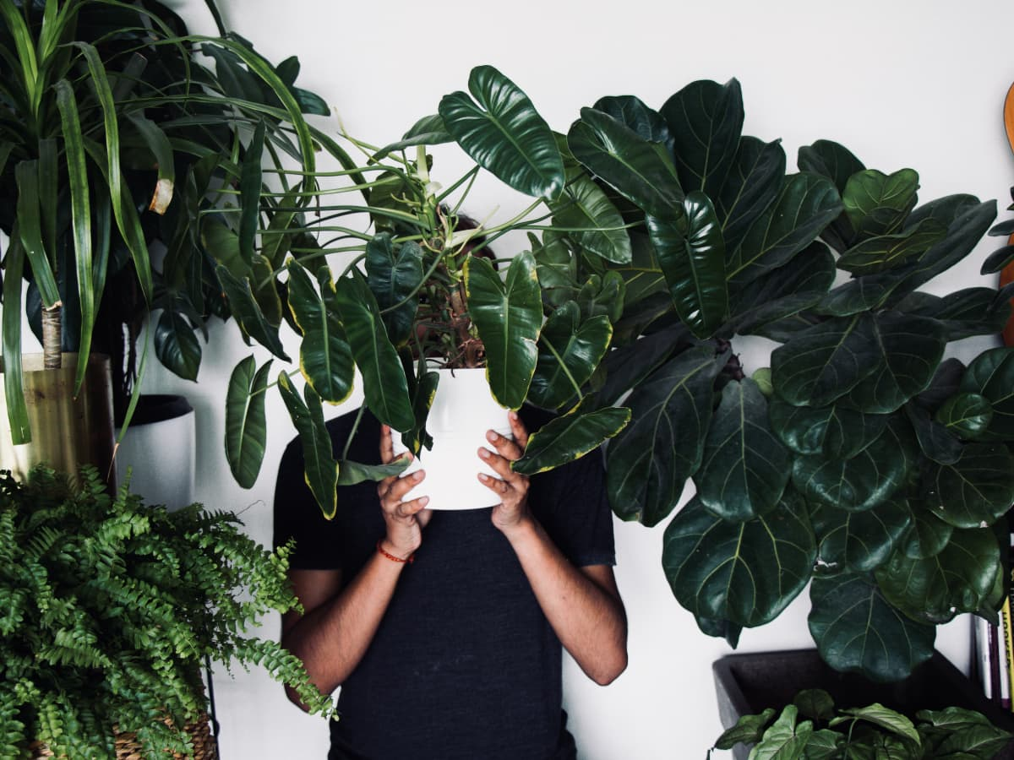
How did we get inspired to build Dr. Greenthumb?
Surrounded with plants at home.
Not having sufficient knowledge of plant disease and its cure.
Wanted to have quick help without having experts to ask.

Slide 3
Plant Disease Classification & LLM Chatbot Integration
Conversational AI
Chatbot prompts the detection & suggests curing methods.
03
User Interface
Use your Webcam or upload an image of your plant. Get help and ask further questions.
01
02
Prediction model
Detection of plant species & diverse common diseases.

Slide 4
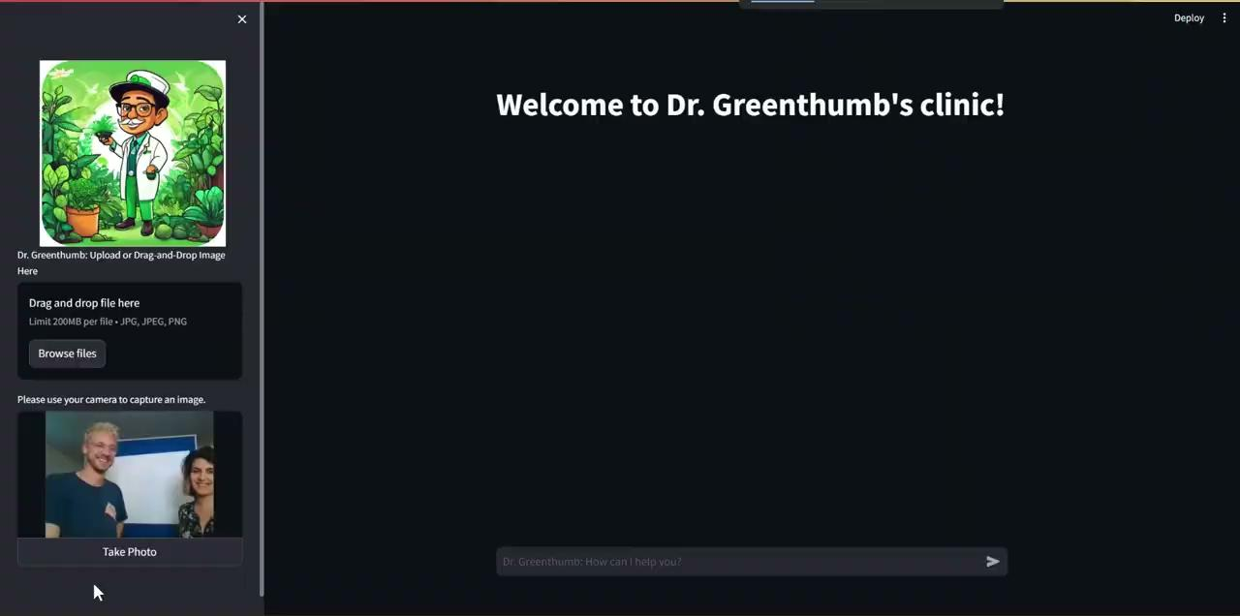

Slide 5

Insights
Test-accuracy for 9 tomato diseases: 98%
Pre-trained LLM & fine-tuned with own data
Web-App: open-source Python framework Streamlit

Slide 6
Challenges
Further Enhancement
Dataset - very little data for houseplants (diseases)
Detection via Webcam
Hardware - local dependencies, memory limit
Processing Time < 2 min
Webcam Object Detection
Automated Model Retraining

Slide 7






Thank you for visiting our clinic.
We look forward to seeing you again.
-Your Dr.Greenthumb Team
Sadia
Sonia
Marvin

Slide 8
Appendix

Slide 9
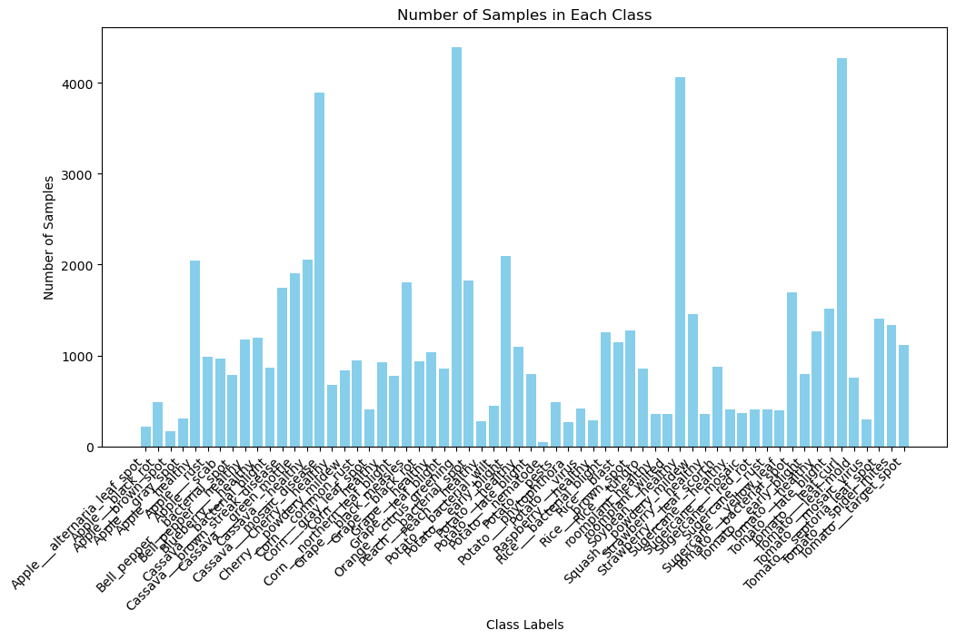
initial data
augmented data
18,000 images in 10 classes: 1 healthy + 9 diseases

Slide 10
Dataset Description
Multi-Class-Image-CNN:
RAG-LLM:
Tomato bacterial spots
Tomato early blight
Tomato healthy
Tomato late blight
Tomato leaf curl
Tomato leaf mold
Tomato mosaic virus
Tomato septoria leaf spots
Tomato spider mites
Tomato target spot
164 PDF pages about the diseases and their treatment

Slide 11
Hardware Specs
CPU: 8 cores
GPU: RTX 3060 (130W)
VRAM: 6 GB
RAM: 32 GB

Slide 12
Libraries used in Dr. Greenthumb
Multi-Class-Image-CNN: | RAG-LLM:
Tensorflow - Keras | LlamaCPP
OpenCV | LangChain
Numpy | RegEx
Matplotlib | Streamlit
Seaborn

Slide 13
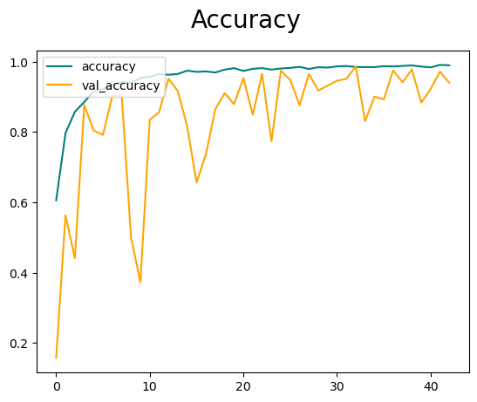
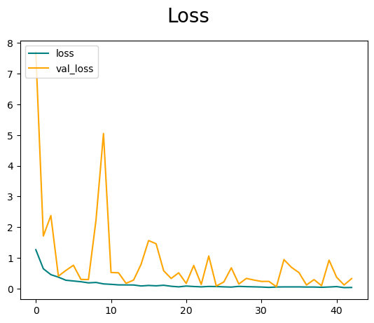
Multi-Class Image Detection - CNN
Model: "sequential"
_______________________________________________________________
Layer (type) Output Shape Param #
===============================================================
resnet50 (Functional) (None, 8, 8, 2048) 23587712
global_average_pooling2d (None, 2048) 0
(GlobalAveragePooling2D)
dense (Dense) (None, 512) 1049088
dropout (Dropout) (None, 512) 0
dense_1 (Dense) (None, 256) 131328
dropout_1 (Dropout) (None, 256) 0
dense_2 (Dense) (None, 128) 32896
dropout_2 (Dropout) (None, 128) 0
dense_3 (Dense) (None, 62) 7998
===============================================================
Total params: 24,809,022
Trainable params: 24,755,902
Non-trainable params: 53,120
Train Performance:
Test Performance:
Accuracy: 0.9868 | Precision: 0.9884
Recall: 0.9831 | F1-Score: 0.9857
Bayesian Optimization
→ Aadam: learning rate = 0.001

Slide 14
RAG - LLM
LLMs | Quantized Mistral 7B Instruct (4.6 GB)
 | Quantized Llama-3 8B Instruct (4.9 GB)
Transformer | All-MiniLM-L6-V2
Vector DB | Chroma
Retriever Search | Maximum Marginal Relevance

Slide 15
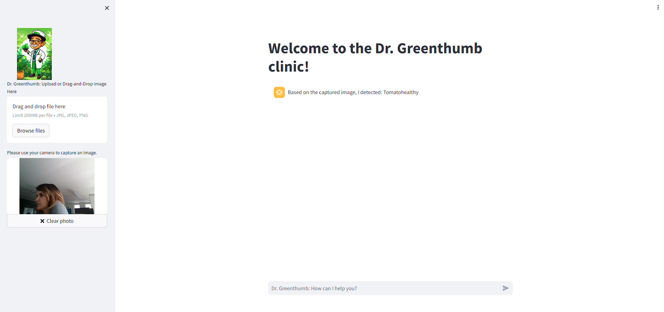

Who knows, maybe I am a tomato plant

